Slide 1
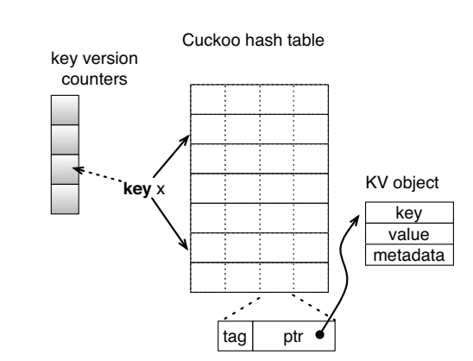
Cuckoo Hashing

Slide 2
The hash table consists of an array of buckets, each having 4 slots. Each slot contains a pointer to the key-value object and a short summary of the key called a Tag. Each slot is of the same length.
To support keys of variable length, the full keys and values are not stored in the hash table, but stored with the associated metadata outside the table and referenced by the pointer. A null pointer indicates this slot is not used.
Each bucket is equal to one cache line.
Each key is mapped to two random buckets, so Lookup checks all 8 candidate keys from every slot.
This results in read of two cache lines from memory.

Slide 3
Inserting in a Cuckoo Hash Table
To insert a new key x into the table, if either of the two buckets has an empty slot, it is then inserted in that bucket
if neither bucket has space, Insert selects a random key y from one candidate bucket and relocates y to its own alternate location.
Displacing y may also require kicking out another existing key z, so this procedure may repeat until a vacant slot is found, or until a maximum number of displacements is reached
If no vacant slot found, the hash table is considered too full to insert and an expansion process is scheduled

Slide 4
Tags are one byte in length
A hash of the key to 8 bits is done (h_{t} (K) = Tag?) and checked with the tag
Probability of a false positive is 1 / 2⁸ = 0.39%

Slide 5
Can we use only tags during inserts also?
hashing scheme computes the two candidate buckets b1 and b2 for key x by
b1 = HASH(x) // based on the entire key
b2 = b1 ⊕ HASH(tag) // based on b1 and hash of tag of x
b2 is still a random variable uniformly distributed;
More importantly b1 can be computed by the same formula from b2 and tag.
This property ensures that to displace a key originally in bucket b—no matter if b is b1 or b2— It is possible to calculate its alternate bucket b’ from bucket index b and the tag stored in bucket b by
b’ = b ⊕ HASH(tag)

Slide 6
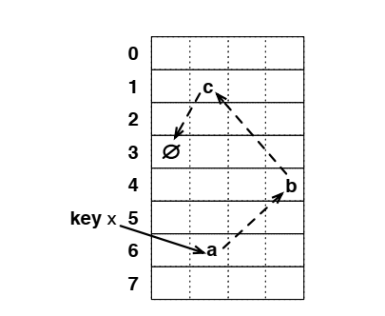
Inserting X by displacing a ->b->c->

Slide 7
The previous diagram shows a displacement path a ->b->c-> empty
How to allow concurrency?
Allow only one writer and multiple readers at any time.
separate discovering a valid cuckoo path from the execution of this path.
First search for a cuckoo path, but do not move keys during this search phase.
2: move keys backwards along the cuckoo path. After a valid cuckoo path is known, we first move the last key on the cuckoo path to the free slot
then move the second to last key to the empty slot left by the previous one, and so on.
As a result, each swap affects only one key at a time, which can always be successfully moved to its new location as it is empty (there is only one writer).

Slide 8
Movement from one bucket to another must be atomic as there will be other readers.
How is this to be done? LEFT AS AN EXERCISE: READ THE PAPER (uploaded in Piazza).

